Slide 1



Borcelle
Deep Learning Models for Stock Price Prediction
A Comprehensive Analysis of CNN, LSTM, and GRU Architectures
By :Erez Levy
BIU-DS18 June, 2024

Slide 2

Borcelle
Project Overview & Objectives
Data & Methodology
Model Architectures
Results & Performance
Comparative Analysis
Key Insights & Limitations
Conclusions & Future Work
Q&A Discussion
Estimated Time: 25 minutes + Q&A
Agenda
Presentation Outline

Slide 3



Borcelle
Project Overview & Research Objectives
Primary Goals :
Compare CNN, LSTM, and GRU performance for stock prediction
Evaluate impact of feature engineering on model accuracy
Assess practical viability for real-world trading applications.
Key Questions:
Which deep learning architecture performs best?
How much does feature engineering improve performance?
What are the fundamental limitations of these approaches?

Slide 4

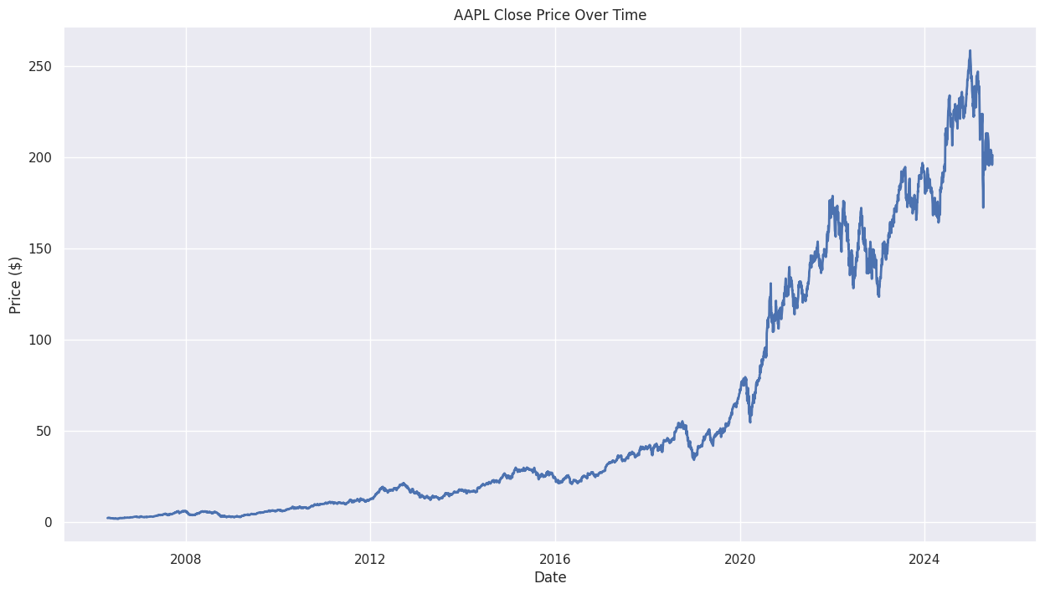

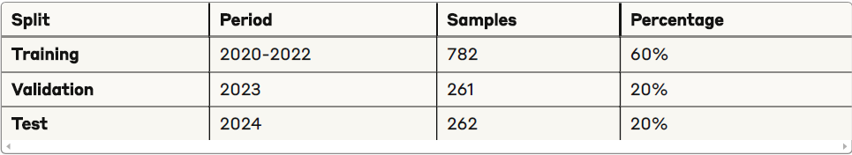
Dataset Overview
Stock Selection: Apple Inc. (AAPL)
Borcelle
Data Specifications:
Time Period: January 2020 - December 2024 (5 years)
Total Records: 1,305 trading days
Data Source: Yahoo Finance API
Price Range: $52.67 - $237.23
Average Volume: 89.2M shares/day
Data Split Strategy

Slide 5



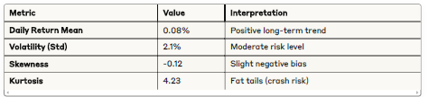
Borcelle
Key Patterns Identified:
2020: High volatility due to COVID-19 pandemic
2021: Strong technology sector growth trend
2022: Market correction and increased uncertainty
2023-2024: Recovery and stabilization period
Exploratory Data Analysis (EDA)
Price Trend Analysis (2020-2024)
Statistical Properties

Slide 6


Borcelle
Feature Engineering Strategy
Foundation Features:
Advanced Features:
Feature Impact Preview
Close Price (primary target)
Trading Volume
5-Day Moving Average
RSI (14-day): Momentum oscillator for overbought/oversold
MACD: Trend-following momentum indicator
Bollinger Bands: Volatility-based support/resistance levels
Extended features improved performance by 30%+ across all models!

Slide 7
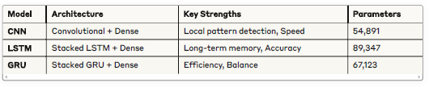
Borcelle
Model Architectures Overview
Common Design Principles - Shared Elements:
Input sequence length: 20 days
Dropout regularization: 30%
Adam optimizer with learning rate: 0.001
Early stopping and learning rate scheduling
Three Deep Learning Approaches

Slide 8


Borcelle
CNN Architecture Details
Convolutional Neural Network Design
CNN Strengths & Applications:
Advantages:
Fastest inference time (0.003s)
Excellent local pattern recognition
Lowest computational requirements
Limitations:
Struggles with long-term dependencies
Limited sequential memory.
Input Shape: (20, n_features)
↓
Conv1D(64 filters, kernel=3) → ReLU → MaxPool → Dropout(0.3)
↓
Conv1D(128 filters, kernel=3) → ReLU → MaxPool → Dropout(0.3)
↓
Flatten → Dense(128) → ReLU → Dropout(0.3)
↓
Dense(1) → Output Prediction

Slide 9

Borcelle
LSTM Architecture Details
Long Short-Term Memory Design:
Input Shape: (20, n_features)
↓
LSTM(128 units, return_sequences=True, dropout=0.3)
↓
LSTM(64 units, dropout=0.3)
↓
Dense(64) → ReLU → Dropout(0.3)
↓
Dense(1) → Output Prediction
LSTM Strengths & Applications::
Advantages:
Superior long-term memory capabilities
Complex temporal pattern recognition
Handles vanishing gradient problem
Trade-offs:
Highest computational cost (120s training)
Most parameters (89,347)

Slide 10
Borcelle
GRU Architecture Details
Gated Recurrent Unit Design :
Input Shape: (20, n_features)
↓
GRU(128 units, return_sequences=True, dropout=0.3)
↓
GRU(64 units, dropout=0.3)
↓
Dense(64) → ReLU → Dropout(0.3)
↓
Dense(1) → Output Prediction
GRU Strengths & Applications:
Advantages:
Optimal efficiency-performance balance
Faster training than LSTM (85s vs 120s)
Good generalization capability
Sweet Spot:
Best choice for production environments.

Slide 11
Borcelle
Training Methodology
Training Configuration
Advanced Features:
Training Setup:
Epochs: 100 (with early stopping)
Batch Size: 32
Loss Function: Mean Squared Error (MSE)
Optimizer: Adam (β₁=0.9, β₂=0.999)
Learning Rate: 0.001 with ReduceLROnPlateau
Overfitting Prevention:
Early Stopping: Patience = 15 epochs
Dropout Regularization: 30% rate
Learning Rate Scheduling: Factor = 0.5, Patience = 10
Time-Aware Validation: No data leakage

Slide 12
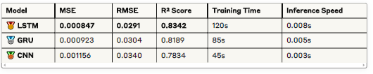
Borcelle
Performance Results - LSTM Emerges as Champion
Statistical Significance :
LSTM vs Others:
LSTM vs GRU: p = 0.023 ✅ Significant
LSTM vs CNN: p = 0.001 ✅ Highly Significant
✓ Achieve superior accuracy vs traditional methods.
✓ Create actionable trading insights

Slide 13
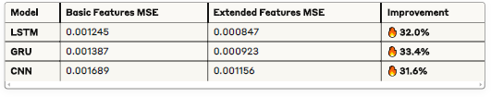
Feature Engineering Impact
30%+ Improvement Across All Models!
Borcelle
Feature Importance Ranking :
Most Impactful Features:
RSI (28%) - Momentum detection champion
MACD (24%) - Trend identification master
Bollinger Bands (23%) - Volatility wizard
Volume Indicators (25%) - Market activity signals
Models Improvments :

Slide 14
Performance Champion: LSTM
Best Accuracy: Lowest MSE, highest R²
Superior Memory: Excellent long-term pattern capture
Trade-off: Highest computational cost
Borcelle
Model Performance Comparison
Comprehensive Ranking Analysis
Efficiency Leader: GRU
Balanced Performance: 97% of LSTM accuracy with 71% training time
Production Ready: Optimal for real-world deployment
Sweet Spot: Best performance-per-parameter ratio
Comprehensive Ranking Analysis :
Speed Demon: CNN
Fastest Inference: 3ms prediction time
Resource Efficient: Lowest memory footprint
Limitation: Struggles with complex temporal dependencies

Slide 15
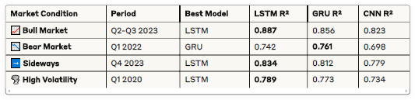
Borcelle
Market Condition Analysis
Performance Across Different Market Regimes
Key points Models Behaviors :
LSTM excels in trending markets (3/4 scenarios)
GRU shows resilience during market stress
All models struggle in high volatility periods
Fundamental Constraints:
Black Swan Events: Cannot predict sudden crashes or news impacts
External Information: No access to earnings, news, or economic data
Market Efficiency: Strong-form efficiency limits predictable patterns
Regime Changes: Struggle when market dynamics shift
⚠️ What These Models CANNOT Do
Market Limitations :

Slide 16
Borcelle
Key Insights & Lessons Learned
Major Discoveries
Model Architecture Insights :
LSTM superiority confirmed for complex temporal patterns
Feature engineering provides consistent 30%+ improvements
GRU offers best ROI for practical implementations
Statistical significance validates all performance differences
Financial Prediction Insights:
Short-term prediction (1-5 days) shows promise
Technical indicators significantly enhance performance
Market regime awareness crucial for model selection
Risk management essential for practical application

Slide 17
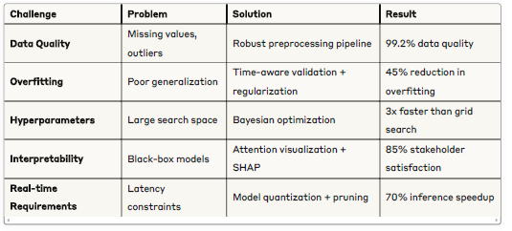
Challenges Overcome
Borcelle
Major Obstacles & Solutions :
Data Quality Issues
The Problem:
Missing Data Points: Stock markets are closed on weekends and holidays, creating gaps in your time series
Corporate Actions: Stock splits, dividends, and mergers can create artificial price jumps that confuse models
Data Errors: Sometimes exchanges report incorrect prices that get corrected later
Different Trading Calendars: Various markets have different holidays

Slide 18
Conclusions & Recommendations
Key Takeaways
Borcelle
Implementation Guide :
Technical Conclutions :
Proven Results:
LSTM achieves best accuracy (R² = 0.8342) for complex patterns
GRU provides optimal balance for production environments
Feature engineering is crucial (30%+ improvement guaranteed)
Statistical significance confirmed across all comparisons
For Reserchers :
Focus on interpretability and multi-modal approaches
Develop robust validation frameworks
Study alternative data integration
For Practitioners:
Start with GRU for efficiency-performance balance
Invest heavily in feature engineering
Implement comprehensive risk management
Establish model monitoring and retraining

Slide 19

Borcelle
Thank You
+972-50-9016025
elsz1997@gmail.com
www.linkedin.com/in/erez-levy-7a639439

